Slide 1
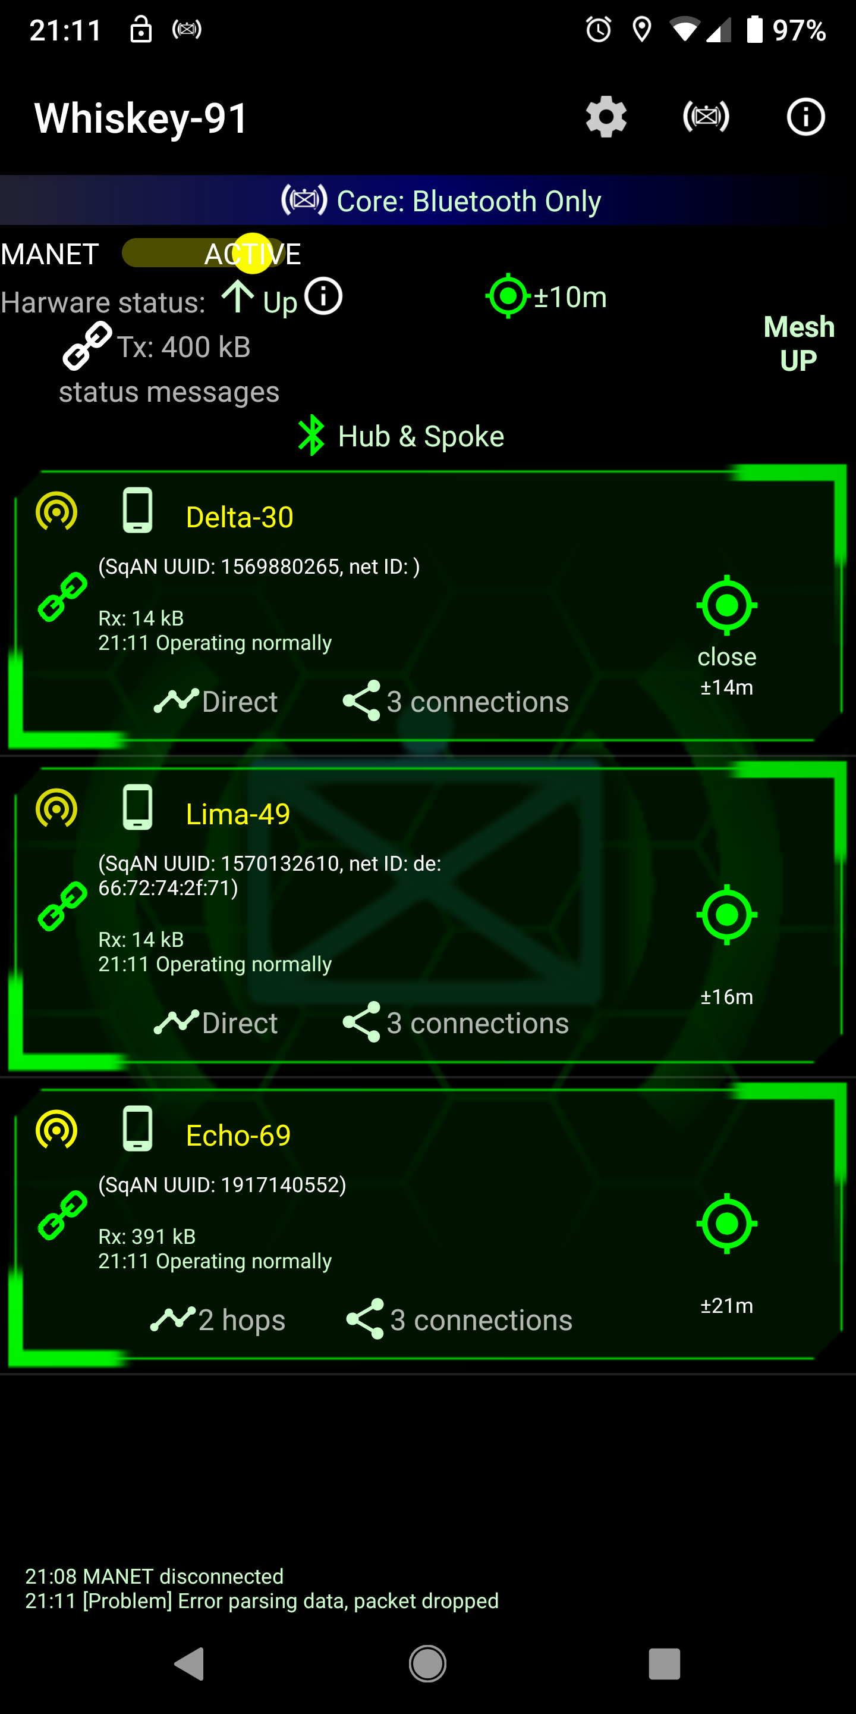
SETUP
1. If this is an old install, switch to “Bluetooth Only” method (the app should recommend you change automatically)
2. Form your team (see next page)
Basic network performance stats are available here.
This device is acting as both a Hub for some devices and a Spoke to other devices. This changes over time.
SqAN is only considered “UP” when this device is receiving information from every teammate.
Receiving a data burst with info about this device
Relative distance to Delta-30 (“close” means the two devices are within their location errors)
Data from Echo-69 is taking 2 hops to get to this device (i.e. data is being relayed by two devices in the middle). Network reconfigures to try to minimize hops so this number drops as the mesh finds more efficient routes.
Echo-69 is exchanging data with 3 other devices.

Slide 2
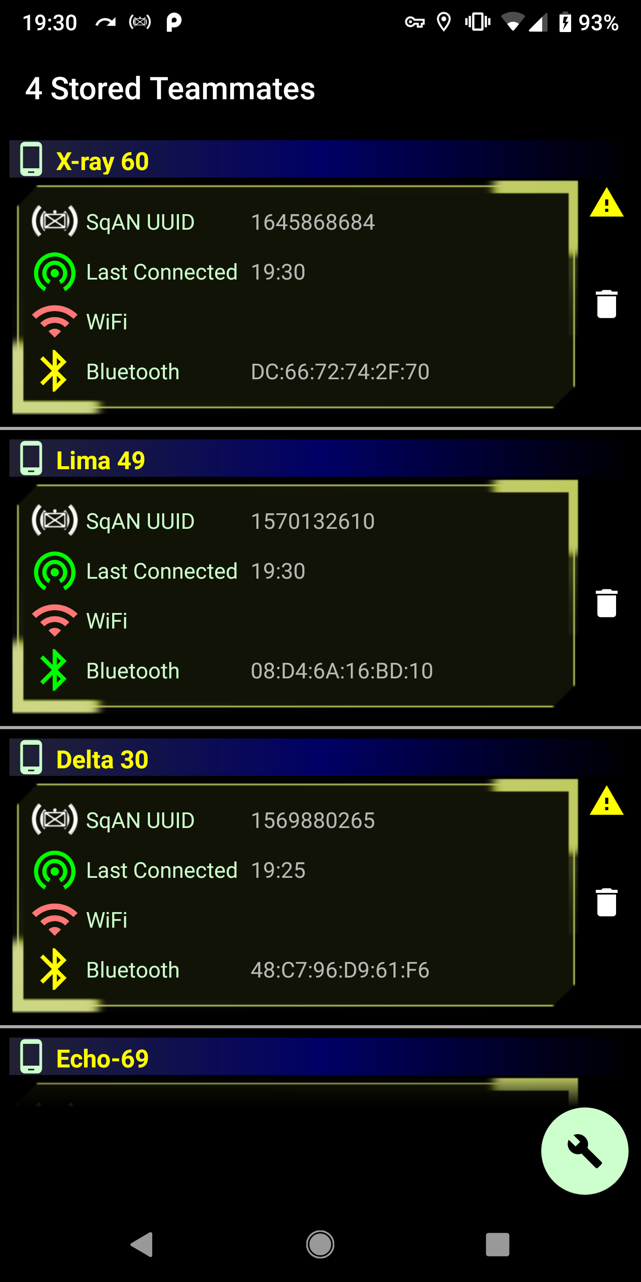
SETUP
This means SqAN isn’t fully set-up to connect with this device
SqAN knows the Bluetooth address of X-ray 60 and Lima 49, but only Lima 49 has been saved as an approved device
SqAN will continually try to connect to every teammate listed. If you no longer want to connect to a device, click on the trash can.
3. The “Fix” button tries to make any changes needed to connect to teammates it also looks for new teammates. Discovery of teammates is automatic, but some things (like Bluetooth) need a one-time approval for pairing.
SqAN will still work with some broken or degraded connections. More, good pairings are better, but SqAN will use the connections it can make and relay data about every device it knows.

Slide 3
Demo Notes Overview
DEMO
SqAN is built to test (i.e. not a production ready app) four different approaches to an open source MANET:
Nearby Connections based – a Google API that appears to have significant stability/scaling problems
WiFi Direct – a widely accessible but structurally limited WiFi capability
WiFi Aware – a significantly advanced WiFi capability available on a very narrow number of devices
Bluetooth – the widest available capability
The current development effort is focused around the Bluetooth mesh capability and building as much stability and bandwidth as possible. A Bluetooth mesh will also exist in parallel to the WiFi Direct and WiFi Aware meshes (which are built and in various stages of testing) to increase bandwidth and stability but is being tested on its own at the time to tune performance.
The most recent emphasis within the Bluetooth mesh has been on self-healing and endurance thresholds. The mesh is tilted right now towards endurance rather than high performance and has recorded stand-by times as long as 96 hours and active reporting as long as 36 hours. As such, the mesh update rate is a little slower than something ideal for a demo or for dynamic on-the-ground movements (but will be adjusted that direction over time).
With the exception of Nearby Connections, the three other mesh approaches are custom built from the ground-up to be optimized for squad level operations.

Slide 4
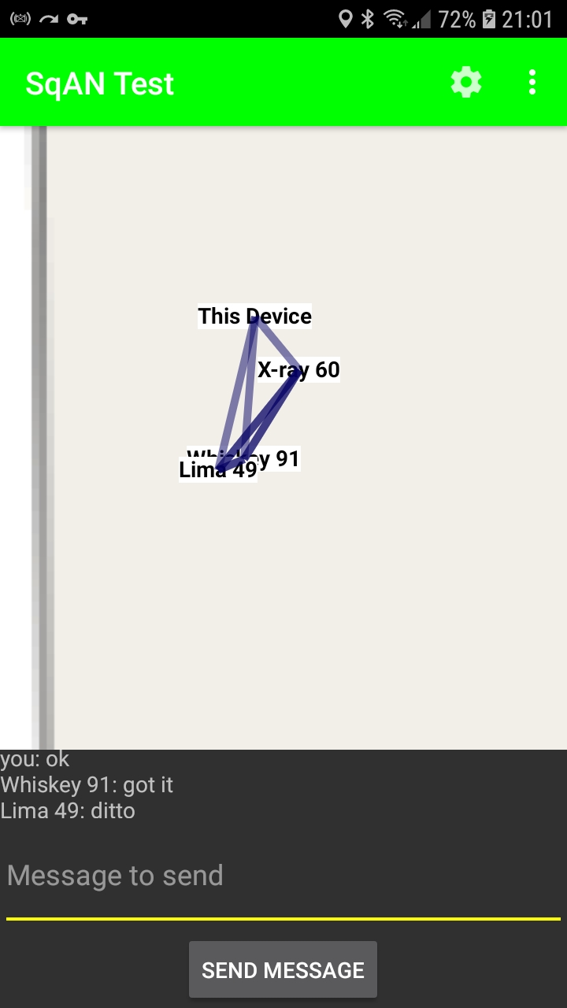
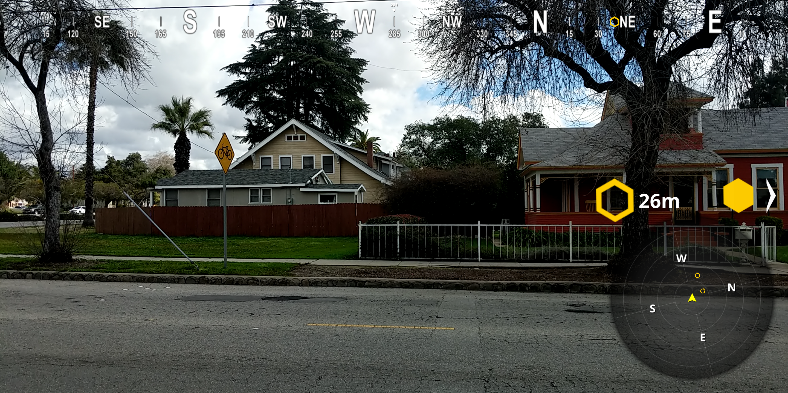
DEMO
Demo feature: Blue Force Tracking
You can use SqAN Test (a separate app in the “testing” folder of the SqAN repo) as a way to see what’s going on in SqAN. SqAN Test will ultimately include load testing capability but for now it’s used to help visualize what’s happening in SqAN and demonstrates the blue force tracking capability inherent in the data SqAN makes available to other apps.
SqAN test shows the connections between devices and will update as the connections and locations change.
SqAN test also includes a very basic chat client. SqAN test needs to be running on another device to receive messages – messages aren’t saved.
BFT capabilities are also available for other app use. Here, SqAN BFT data is used real time in a mobile Unity AR app.

Slide 5
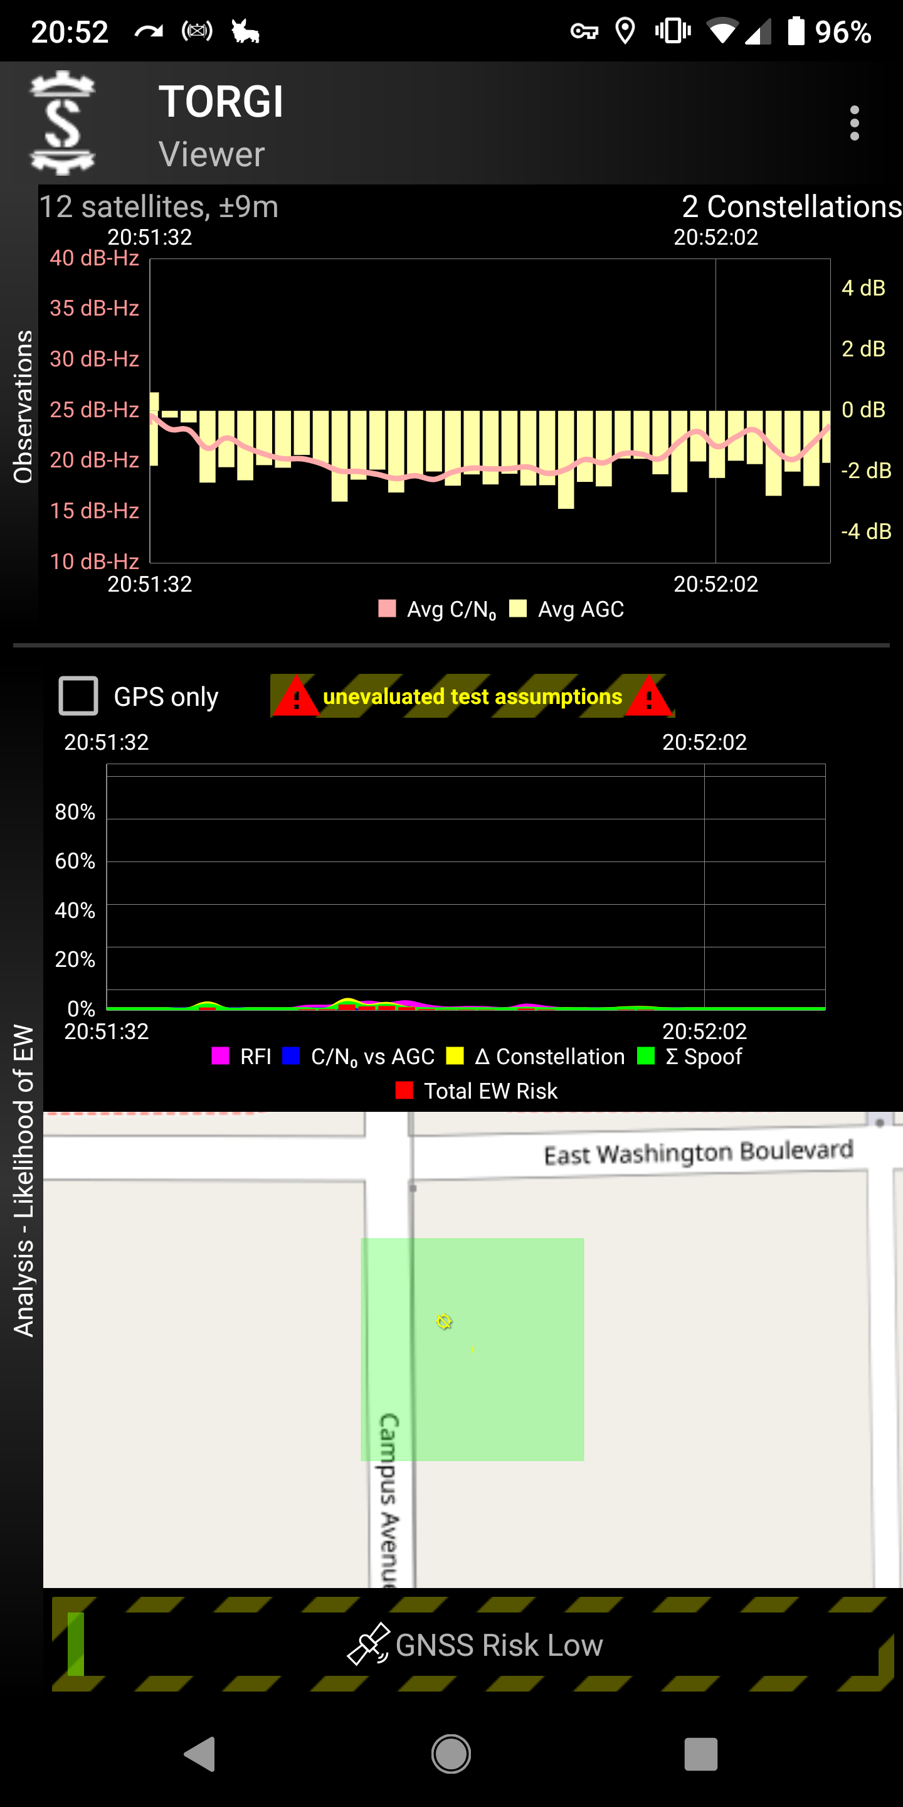
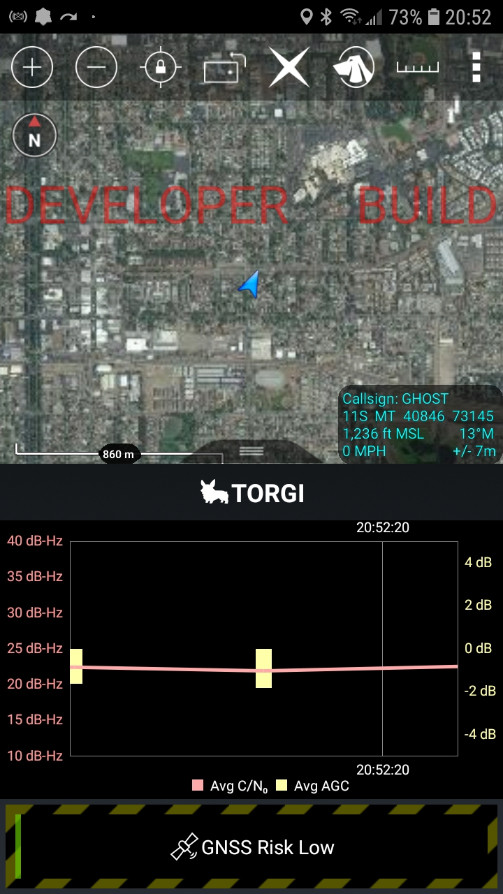
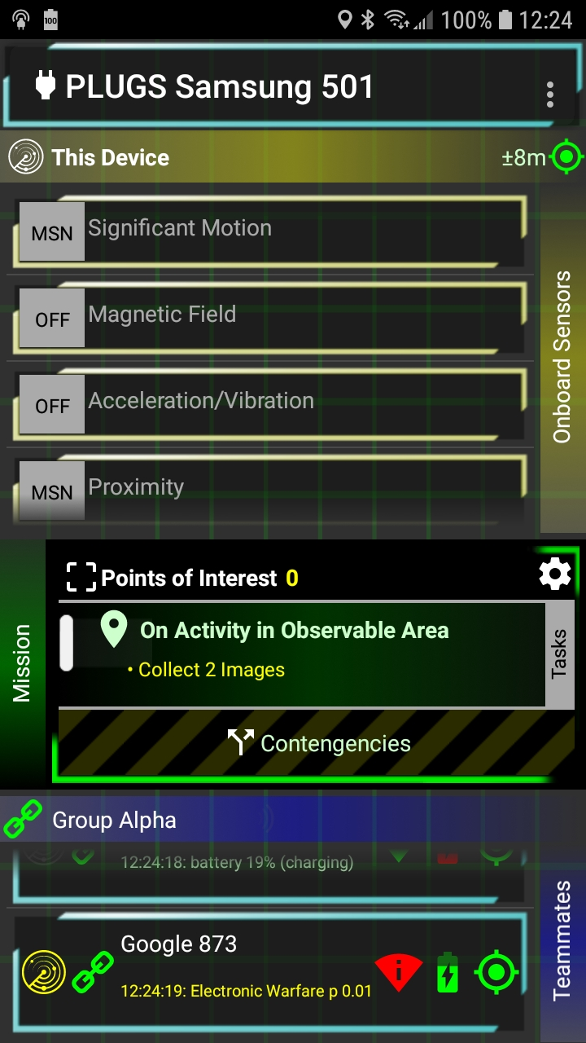
DEMO
Demo feature: Inter-App Communications
SqAN automatically takes some optimized communications and passes them between apps across SqAN. For example, TORGI data collection can be viewed within ATAK on a different device. (Note, here the communications are an extension of the OGC SOS standard for sensors)
TORGI running on one device
Can be viewed in ATAK on another device
SqAN also provides a capability to use app-specific channels for communication within the same app. Another ongoing SOFWERX initiative PLUGS uses SqAN to automatically connect unattended sensors that temporarily or permanently lose backhaul connectivity and relay their traffic over an exfil network to collection servers. SqAN’s self-healing and multi-path capability allow spontaneous changes to network structure to provide continued collection without human intervention..

Slide 6
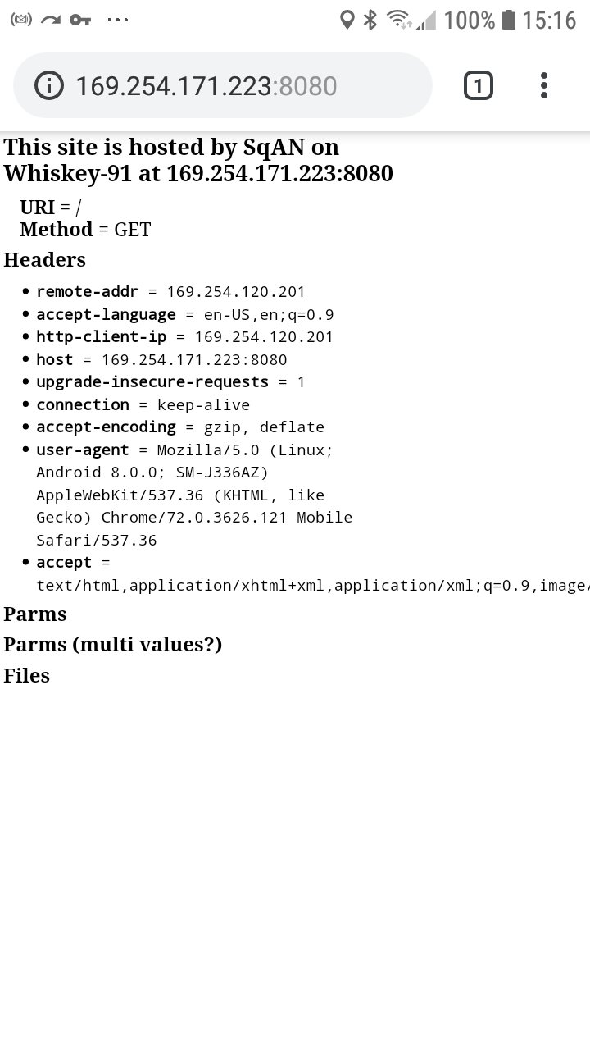
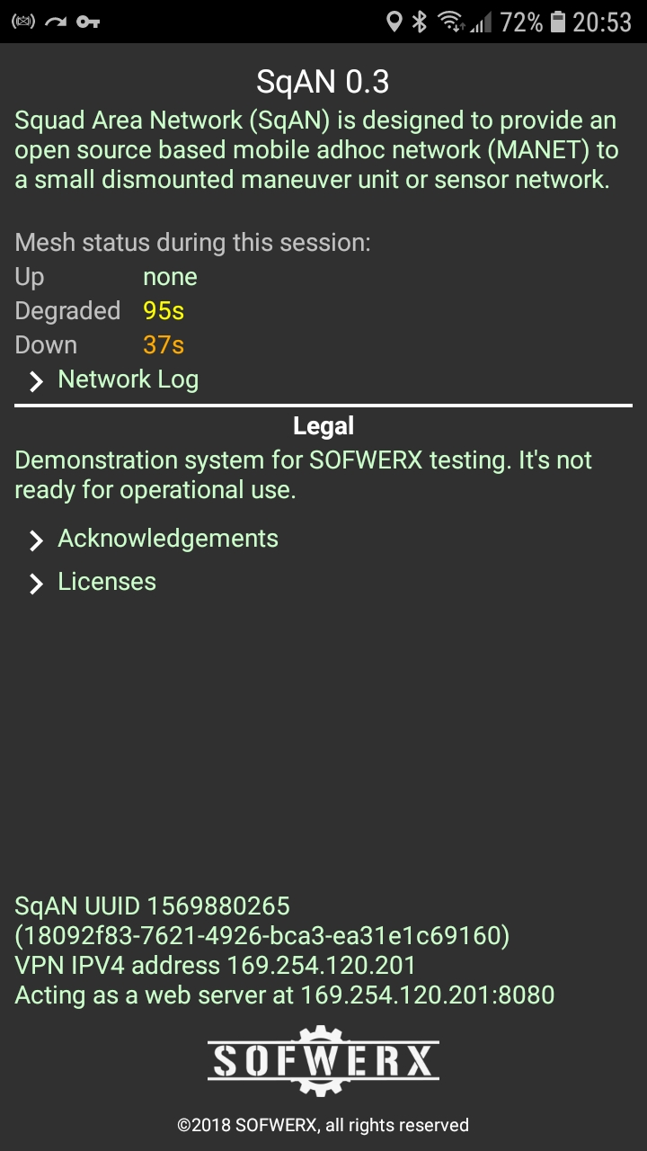
DEMO
Demo feature: VPN
SqAN contains a VPN that will automatically re-route TCP/IP traffic between devices on SqAN. This is built to let any TCP/IP based app communicate over SqAN without any changes in the app.
To demo the VPN use, in a web browser go to the IP address of any other device on SqAN
Each device also hosts a web page and will accept TCP/IP traffic

